Slide 1
Data Modeling
Dr. Ernesto Lee

Slide 2
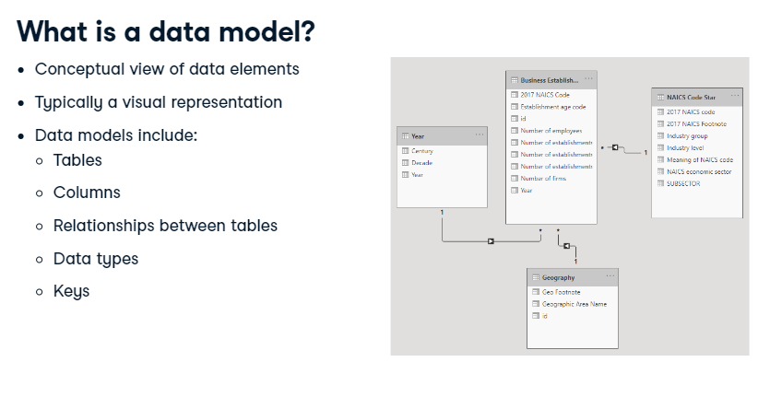
Notes:
So, what is a data model? In short, a data model is a conceptual view of data elements. Typically, this is done in the form of a diagram. Data models include tables, columns, and relationships between tables. They can also include information on data types and keys.

Slide 3
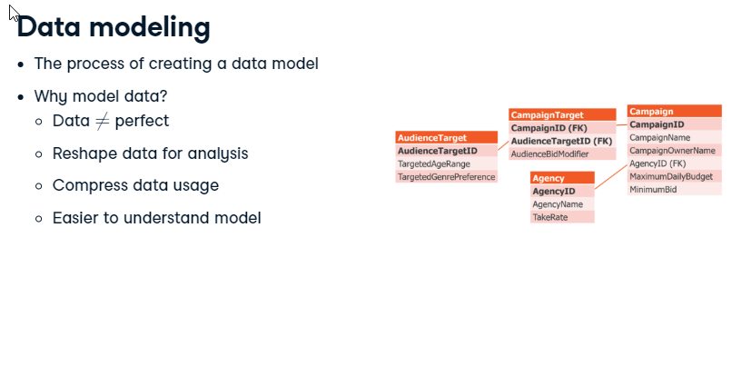
Notes:
Data modeling is the process of creating a data model. It's a critical part of Power BI development. Incoming data usually needs some cleanup and often substantial alterations to the data to find the right insights. This includes changing columns to join together disparate tables, removing non-data rows, or comprehensive changes like pivoting tables. As a result, data modeling techniques can shrink down the amount of disk space needed to store and process data, which improves speed. Finally, data modeling makes the model easier for business users to interpret.

Slide 4
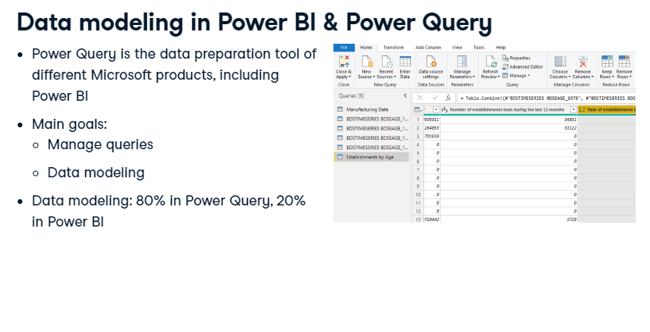
Notes:
Data modeling in Power BI is mainly handled by Power Query, the query editor for Power BI and other Microsoft products, like Excel. Its main purpose is to manage the queries which drive dashboards and reports, but also to assist with data modeling. Power Query directly changes the data, such as removing columns. You define your base changes in Power Query, and perform fine-tuning steps in Power BI.

Slide 5
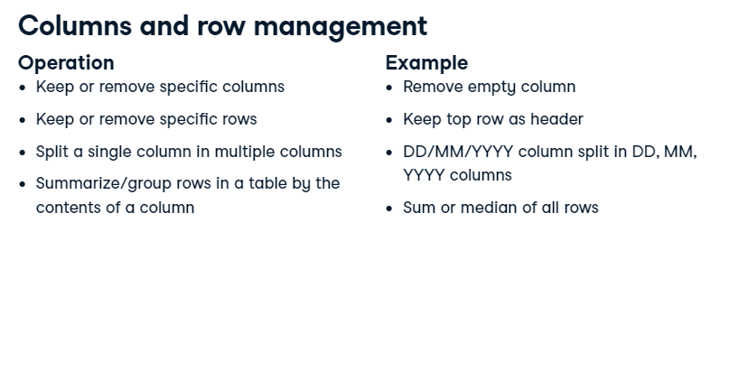
Notes:
Let's overview some key data modeling steps you can do in Power Query and Power BI. On a column and row level, there are several options, such as removing specific columns, using the first row as the header, breaking out a lengthy column into multiple, independent columns, or summarizing data in a table and grouping it by another column.

Slide 6
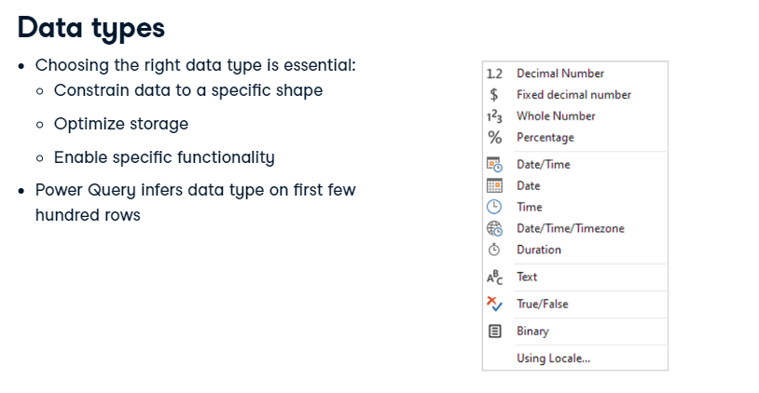
Notes:
In Power Query and Power BI, columns can be assigned to data types. The motivation is to constrain your data, ensuring that values match expectations. This can also optimize storage: the numeric value 1,000,000 fits in four bytes but would take nine bytes as a string. Some functionality is limited to specific types--for example, date arithmetic is only possible on date and time columns. Power Query usually correctly infers the data types of columns, and does so using the first few hundred rows.

Slide 7
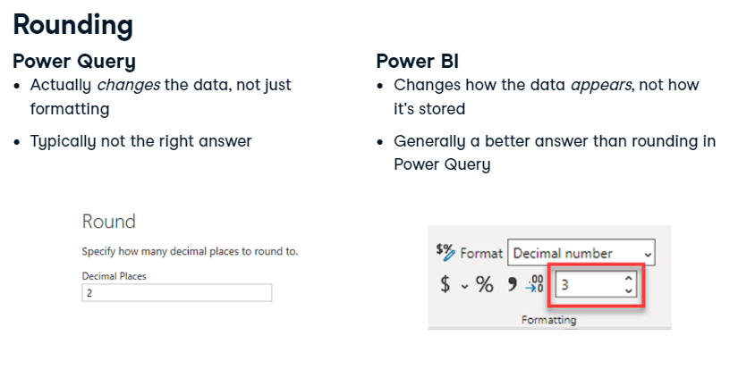
Notes:
We could also specify decimal places in Power Query. This actually changes the loaded data, so it isn't just a formatting choice. This is useful when there are strict rounding rules. However, typically, we want to round after performing all calculations, so rounding in Power Query is uncommon. Formatting within Power BI itself changes the data's appearance but doesn't affect the stored data. Thus, rounding happens after any calculations. Therefore, we usually prefer rounding here than in Power Query. You now know a few key ways to alter data in Power BI, but these aren't the only ones. You'll discover more during the upcoming videos and exercises about string operations and other column modifications!

Slide 8
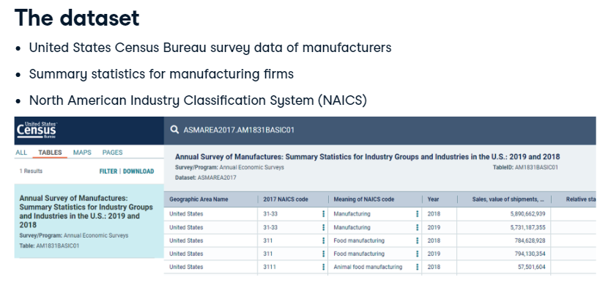
Notes:
The dataset we'll be using comes from the United States Census Bureau and summarizes survey data asked of manufacturing firms in 2018 and 2019. It contains a variety of measures around payroll and numbers of employees for several industries according to the North American Industry Classification System (or NAICS). In later exercises, we'll extend this dataset with geography, time, and other dimension tables.

Slide 9
Load and Clean the Data
https://github.com/fenago/cts2451/blob/main/modelling/Datasets/manufacturing_data.csv
Notes:
Load the Data and Clean it

Slide 10
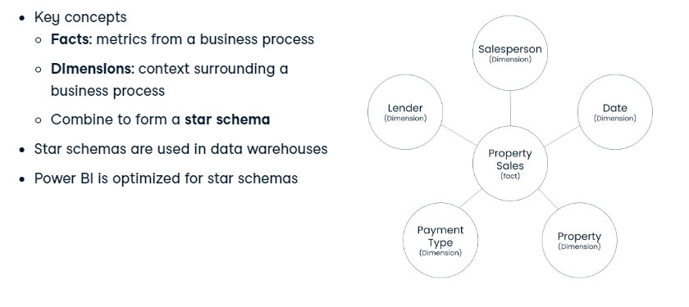
Notes:
Earlier, you learned that data models provide a conceptual representation of data elements and the relationships between them. There are many approaches to data modeling. We'll focus on one, the dimensional model.
2. The Kimball Model
The Kimball model, otherwise known as the dimensional model, is one of the most popular approaches to data modeling.
3. The Kimball Model
There are two key concepts in the Kimball model: facts and dimensions. Facts are the metrics from your business process. Dimensions provide the context surrounding a business process. These combine to form a star schema. The star schema's name comes from the way that facts and dimensions connect. We typically have several dimensions surrounding each fact. In this example, measures related to Property Sales are stored in the fact table, and the Lender, Salesperson, Date, Property, and Payment Type tables provide more context about each property sale. Huge amounts of data are organized in this way in data warehouses. Power BI is optimized to use star schemas over any other way of loading data, so Power BI is faster and easier to use with a dimensional approach.

Slide 11
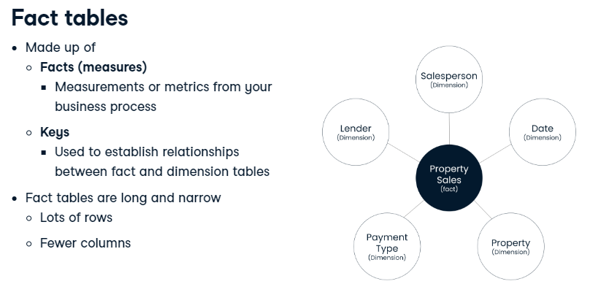
Notes:
Fact tables
Let's take a closer look at fact tables first. A fact table typically has two types of columns; facts and keys. Facts are the measures or metrics from your business process. Examples include sales, employee count, or number of website visits. They are generally dates and numbers which we can aggregate in some way. Keys are how we establish relationships between fact tables and dimension tables. We expect fact tables to be tall and narrow. They have lots of rows, so we try to minimize the number of columns and how big those columns are.

Slide 12
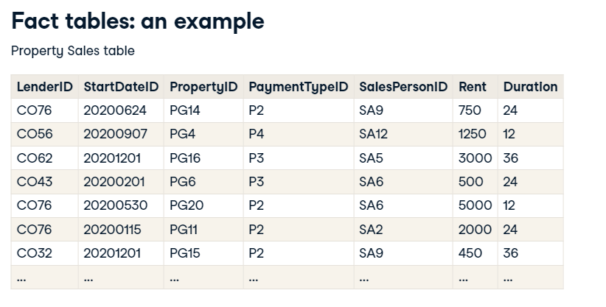
Notes:
**Keys establish a relationship between the tables
**Measures from the business process
Fact tables: an example
Here is an example of a fact table, Property Sales. Each row represents a property that was rented at a specific date.
6. Fact tables: an example
The first five columns contain keys or IDs that are used to link to each of the dimension tables. You'll find more information about the lender, date, property, payment type, and salesperson there.
7. Fact tables: an example
The last two columns hold the measures. Here we're tracking the rent, in dollars, and the duration of the rental agreement, in months.

Slide 13
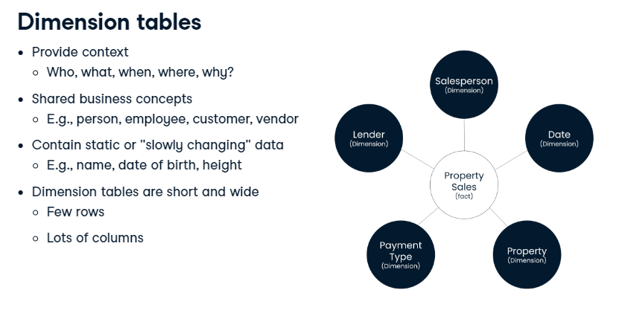
Notes:
Next, we'll look at dimension tables which provide the context around facts. A fact may tell you how much or how often, but dimensions give the rest of the story. Who did it, how they did it, where they did it, and so on. Dimensions are shared business concepts, usually in the form of a noun such as Person, Employee, Customer, and Vendor. Dimensions contain static or slowly-changing data. Think of information like names, dates of birth, and height. Dimension tables are typically short and wide. They don't contain that many rows, but do contain a large amount of context for the facts.

Slide 14
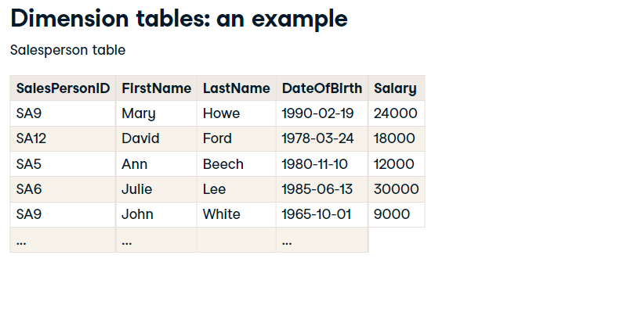
Notes:
**Attributes are various characteristics of the dimension
Dimension tables: an example
Let's take a look at an example. Here you can see the Salesperson table.
10. Dimension tables: an example
The first column contains the same key as in the fact table and can be used to combine the information from both tables.
11. Dimension tables: an example
The table also stores additional attributes about each salesperson in the company.

Slide 15
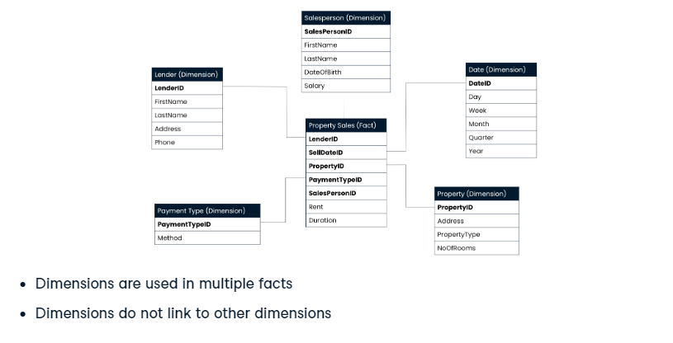
Notes:
Star schema
Here's that same star schema from before. In the Kimball model, dimensions are often used in multiple facts. These dimensions surrounding Property Sales could provide context to a different fact table as well. In a star schema, dimensions do not link to other dimensions.

Slide 16

Notes:
This chapter will continue with the Census data about establishments active in the manufacturing sector. In the exercises, you will be creating a fact table that contains measures like number of employees, number of firms, and so on. Additionally, there will be more information about the establishment in the form of dimension tables. These include data on the industry, time, age, and geography of the establishments.

Slide 17
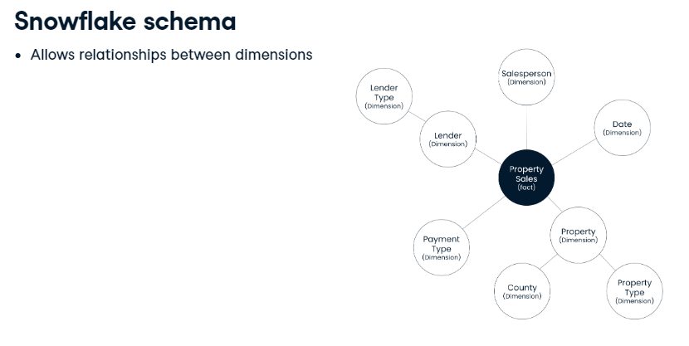
Notes:
. Star schema
Remember from earlier that a star schema consists of one or more fact tables surrounded by dimension tables.
3. Snowflake schema
The snowflake schema is like a star schema, except it allows relationships between dimensions. In the example you can see that the Lender and Property dimensions each link to other dimension tables. Note that fact tables remain the same.

Slide 18
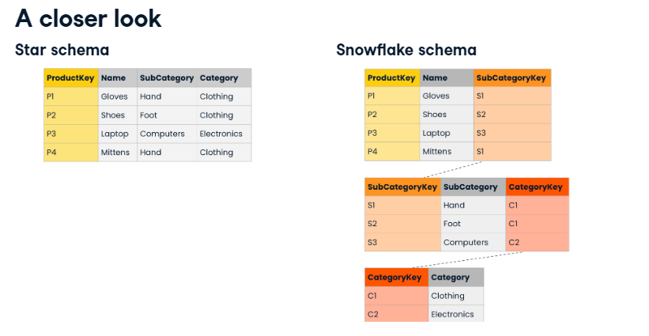
Notes:
A closer look
The biggest difference between the two styles is how they handle hierarchical data. Star dimensions tend to have all levels of a hierarchy in the same table, whereas with snowflake dimensions, hierarchy levels are explicitly broken out into multiple tables. Here you can see a Product dimension table. Imagine that each product has a name. Each product also belongs to a product subcategory, which itself belongs to a product category. In a star schema, all levels of the hierarchy, as well as their attributes, show up on the same product dimension. With a snowflake schema, each level of the hierarchy becomes its own table and we join those tables, usually with keys.

Slide 19
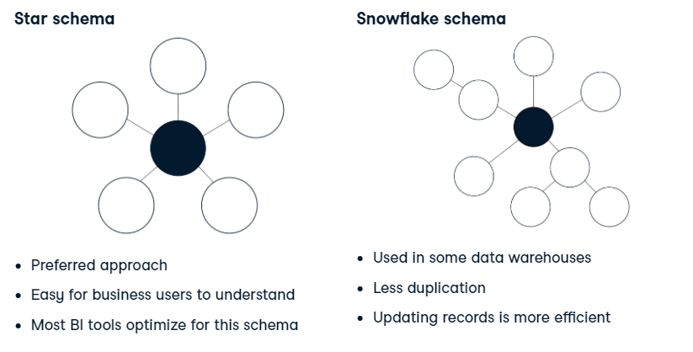
Notes:
Comparison
When it comes to dimensional modeling theory, we strongly prefer star schemas over snowflake schemas. The key reason is that star schemas are easier for business users to understand. They don't want to worry about keys or hierarchies. The other benefit is that quite a few business intelligence tools have been optimized for the star schemas. Although dimensional modeling theory leans heavily toward star schemas, we do see snowflake schemas in some data warehouses. The reason for this is that star schemas duplicate quite a bit of data, which leads to storage costs and can impact performance. Also, star schemas are not ideal for frequently-updated data, especially with large dimensions. Suppose you have millions of rows in a dimension containing a column for country. When a country name changes, you may have to update a large number of rows with the new country name. By contrast, with a snowflake schema this would be an update of a single row.

Slide 20
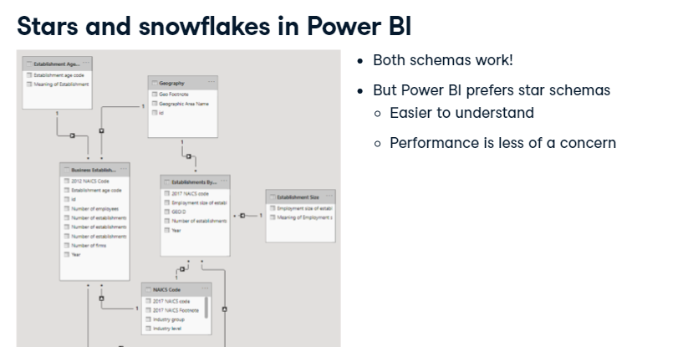
Notes:
Stars and snowflakes in Power BI
When it comes to Power BI in particular, it is important to note that both schemas work. If you have a snowflake schema in an existing warehouse, you could import the data as-is, making migrations easier. That said, Power BI does prefer star schemas for the same reason as dimensional modeling theory. Because it is easier for users to understand. Furthermore, there are some optimizations in Power BI which make performance much less of a concern.

Slide 21
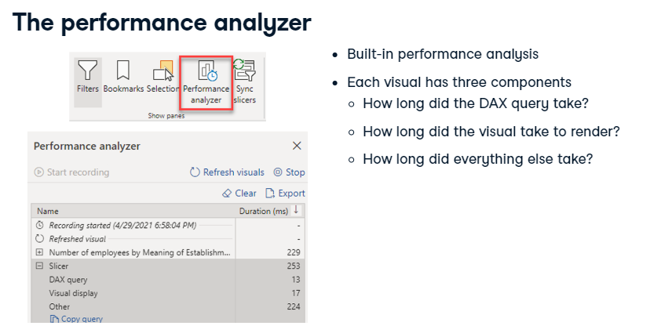
Notes:
The performance analyzer
Power BI has a built-in performance analyzer. When enabled, it keeps track of at least three key measures on each visual. The first is how long it took to read the data from its internal database and then perform any DAX operations on the data. The second component is figuring out how long it took the visual to render. Finally, a third measure captures everything else, which is typically waiting time on other operations, including waiting for cross-filtering operations to complete.

Slide 22
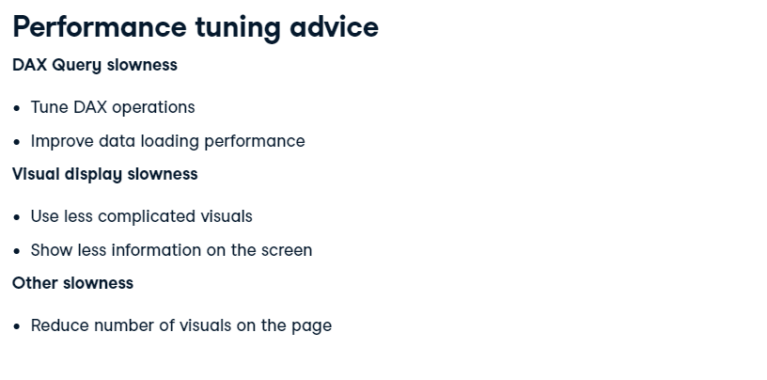
Notes:
Performance tuning advice
There are a number of ways you can improve performance. If the DAX query takes a long time to complete, you could tune your DAX operations or improve your data loading performance. This might include improving your data model! If the big problem is in visual display, use less complicated visuals and show less information on the screen. Power BI needs to render each data point, so plotting tens of thousands of points may take a while. If the Other value is the cause of your slowness, you might want to reduce the number of visuals on the page.
9. Let's practice!

Slide 23
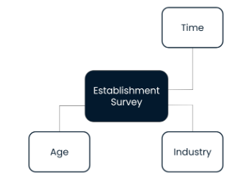
Which subsector has the highest average number of employees?
How many employees did the Food Manufacturing subsector count on average in the 90’s?
How many average employees did 3-year old firms in the Food Manufacturing subsector have in the 90’s?

